Slide 1
Automobile Market Analysis Project
Student Name: Ayush Burman
Batch Code: DA464S46
Project Guide: Komilla Bhatia

Slide 2
Problem Statement
By performing automobile market research analysis, we are able identify different car makes and models which are suitable for various specific purposes. By analyzing car dataset we can identify key factors for potential car model launches. We will also observe fuel efficiency to understand the driving patterns and be able to identify which cars are most fuel efficient, which will further help us to identify opportunities for reducing carbon emissions and having environmentally friendly cars.
Objective
Find the most popular car body type.
Identify a car that would be best suited for adventurous drives.
Identify the top two manufacturers who offer the highest range of car variants.
Identifying opportunities for reduced emissions: Group cars by fuel efficiency.
Compare fuel efficiency across various fuel types: Analyse fuel efficiency distribution.

Slide 3
Observations about Data and Pre-Processing techniques
Raw data was provided to us for performing Automobile Market Research Analysis. The raw data contained various missing values and unstandardized units that had to be fixed as per our needs and data requirements.
Pre-Processing techniques consisted of filtering out the required data, taking the required columns for analysis, and converting the required data into Pivot Tables as well for better analysis and visualization purposes.
Along with importing, cleaning and formatting the data, checking for missing values and inconsistencies, it was required to convert categorical variables to numerical codes(e.g., 1. CNG, 2. Petrol for Fuel Types etc). Data preprocessing also involved calculating additional fuel efficiency metrics like calculating Avg. Combined Milage and Distance using their respective formulas.

Slide 4
Insights from the analysis
1: Top 10 cars with highest miles per
gallon
Graph
2: Top 10 cars with highest miles per
gallon based on displacement
Graph
Interpretation: Top 10 cars with highest miles per gallon consists of make Suzuki, Tata, Hyundai, Mahindra and Renault.
Interpretation: Top 10 cars with highest miles per gallon based on displacement consists of make Suzuki, Tata, Renault, Hyundai and Mahindra.

Slide 5
Insights from the analysis (continued)
3: Top 3 manufactures with highest
numbers of hatchback cars
Graph
4: Compare mileage of the cars.
Graph
Interpretation: The top 10 cars with the highest miles per gallon are from the manufacturers Tata, Suzuki, Renault, Mahindra and Hyundai.
Interpretation: Tata, Hyundai and Suzuki are the top 3 manufacturers with highest number of hatchback cars.

Slide 6
Insights from the analysis (continued)
5: Relationship between
displacement and mileage
Graph
6: Relationship between mileage
and fuel tank capacity
Graph
Interpretation: As per the above graph there is a negative relationship between Milage and Displacement.
Interpretation: As per the above graph there is a negative relationship between milage and fuel tank capacity.

Slide 7
Insights from the analysis (continued)
6: Best cars for the adventurous
drives
Graph
7: Best family cars
Graph
Interpretation: One of the best cars suited for family usage is Volkswagen Vento as per the analysis.
Interpretation: The best car suited for adventurous drives is Toyota LandCruisor as per the analysis.

Slide 8
Insights from the analysis (continued)
8(i):Car manufactures for compact
city
Graph
8(ii): Car manufactures for family
car
Graph
Interpretation: As per the above graph the top car manufacturers for compact city are Tata, Hyundai and Suzuki.
Interpretation: As per the above graph car manufacturers for family usage are Suzuki, Hyundai, Volkswagen, Skoda.

Slide 9
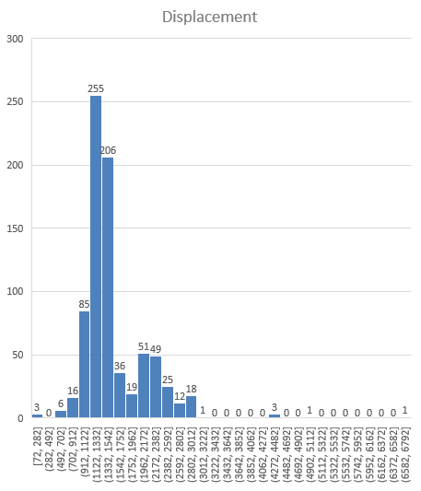
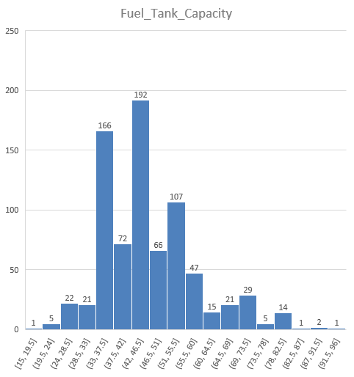
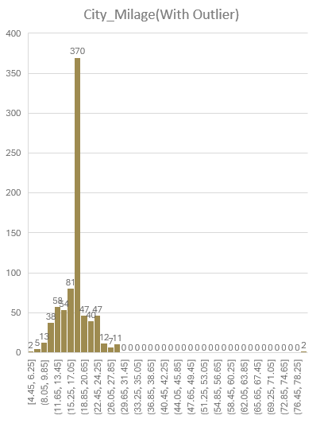
Insights from the analysis (continued)
9 : Outlier Analysis
Displacement Histogram
City Mileage Histogram
Fuel Tank Capacity Histogram
Interpretation: The outlier city milage in this histogram is in the range of 1122-1332.
Interpretation: The outlier city milage in this histogram is in the range of 15.25-17.05.
Interpretation: The outlier city milage in this histogram is in the range of 42-46.5.

Slide 10
Insights from the analysis (continued)
10 : Top 3 manufactures
Hatchback Category
Sedan Category
SUV Category
Interpretation: From the above graph the top 3 manufacturers in the hatchback category are Tata, Hyundai and Suzuki.
Interpretation: The top 3 manufacturers in the Sedan category are Toyota, Skoda and Hyundai.
Interpretation: The top 3 manufacturers in the SUV category is Hyundai, Tata and Mahindra.

Slide 11
Insights from the analysis (continued)
11 : most popular car body type by count
Hatchback Category
Sedan Category
SUV Category
Interpretation: Most popular manufacturer in the Hatchback category is Suzuki.
Interpretation: Most popular manufacturer in the Sedan category is Hyundai.
Interpretation: Most popular manufacturer in SUV category is Mahindra.

Slide 12
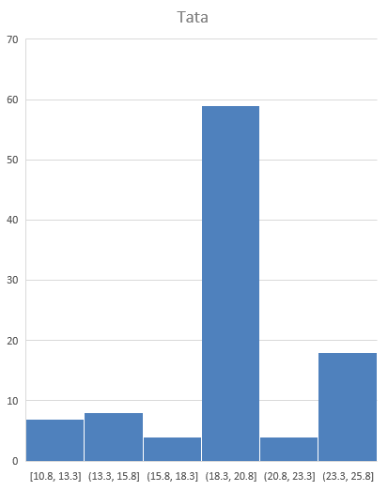
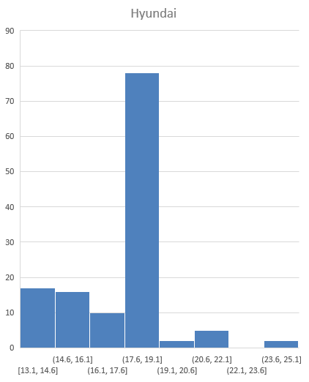
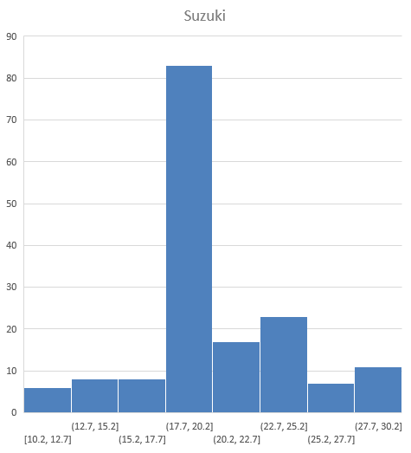
Insights from the analysis (continued)
The manufacturer who offers the widest variation of city mileage
Tata
Maruti Suzuki
Hyundai
Interpretation: From analysis, Tata has the 2nd widest variation among these three makes.
Interpretation: From analysis, Suzuki has the widest variation among these three makes.
Interpretation: From analysis, Hyundai has the 3rd widest variation among these makes.

Slide 13
Insights from the analysis (continued)
Does Fuel_Tank_Capacity have any impact on City_Mileage
Graph
Is there any association between Fuel_Tank_Capacity and Displacement
Graph
Interpretation: There is a negative correlation between City Milage and Fuel Tank Capacity.
Interpretation: There is a positive correlation between Displacement and Fuel Tank Capacity.

Slide 14
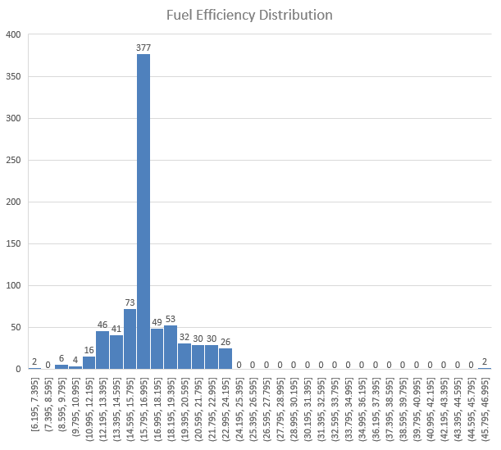
Insights from the analysis (continued)
top two manufacturers with the
widest range of cars variants
Graph
fuel efficiency distribution
Graph
Interpretation: From this above graph we can see that the top 2 manufacturers with the widest range of cars variants are Suzuki and Hyundai.
Interpretation: From this above fuel efficiency distribution graph we can see that the fuel efficiency between 15.75 to 16.99 is the most, an outlier across all car makes and models.

Slide 15
Insights from the analysis (continued)
Association between average speed
and fuel efficiency
Graph
Correlation between distance
driven and fuel efficiency
Graph
Interpretation: There is a positive correlation between Avg. Combined milage and Fuel Efficiency
Interpretation: There is a positive correlation between Distance and Fuel Efficiency.

Slide 16
Insights from the analysis (continued)
FUEL EFFICIENCY DASHBOARD
Petrol
Electric
Diesel
Interpretation: Suzuki has the most fuel efficiency in Petrol.
Interpretation: Tata has the most fuel efficiency in Electric.
Interpretation: Mahindra has the most fuel efficiency in Diesel.
CNG
CNG + Petrol
Hybrid
Interpretation: Suzuki has the most fuel efficiency in CNG.
Interpretation: Hyundai has the most fuel efficiency in CNG+Petrol.
Interpretation: Toyota has the most fuel efficiency in Hybrid.

Slide 17
Insights from the analysis (continued)
AVERAGE SPEED AND DISTANCES DRIVEN DASHBOARD
Petrol
Electric
Diesel
Interpretation: For the maximum distance of more than 2500 the Avg. Speed is 46.8.
Interpretation: For the maximum distance of 1400 the Avg. Speed is 15.8.
Interpretation: For the maximum distance of more than 1200 the Avg. Speed is 15.95.
CNG
CNG + Petrol
Hybrid
Interpretation: For the maximum distance of close to 1000 the Avg. Speed is 16.
Interpretation: For the maximum distance of more than 700 the Avg. Speed is 19.45
Interpretation: For the maximum distance of 800 the Avg. Speed is 16.

Slide 18
Summary
Summarize all the important points:-
(1) Problem Statement: What problem are we trying to solve?
By performing automobile market research analysis, we are able identify different car makes and models which are suitable for various specific purposes. By analyzing car dataset we can identify key factors for potential car model launches. We will also observe fuel efficiency to understand the driving patterns and be able to identify which cars are most fuel efficient, which will further help us to identify opportunities for reducing carbon emissions and having environmentally friendly cars.
(2) Top 10 cars with highest miles per gallon and highest miles per gallon based on displacement?
This category consists of the makes Suzuki, Tata, Mahindra, Renault and Hyundai.
(3) There is a negative relationship between Milage and Displacement. There is also a negative relationship between milage and fuel tank capacity.
(4) The top car manufacturers for compact city are Tata, Hyundai and Suzuki. The car manufacturers for family usage are Suzuki, Hyundai, Volkswagen, Skoda. The best car suited for adventurous drives is Toyota LandCruisor based on analysis.
(5) The top 2 manufacturers with the widest range of cars variants are Suzuki and Hyundai.
(6) Highest Fuel Efficiency consists of Make Mahindra and Tata. Moderate Fuel Efficiency consists of Make Mahindra and Hyundai. Lowest Fuel Efficiency consists of Make BMW.

Slide 19
Conclusion
Find the most popular car body type.
(Answer) The most popular body type is Hatchback.
2. Identify a car that would be best suited for adventurous drives.
(Answer) The best car suited for adventurous drives is Toyota LandCruisor based on analysis.
3. Identify the top two manufacturers who offer the highest range of car variants.
(Answer) The top 2 manufacturers with the widest range of cars variants are Suzuki and Hyundai.
4. Identifying opportunities for reduced emissions: Group cars by fuel efficiency.
(Answer) Highest Fuel Efficiency consists of Make Mahindra and Tata. Moderate Fuel Efficiency consists of Make Mahindra and Hyundai. Lowest Fuel Efficiency consists of Make BMW.
5. Compare fuel efficiency across various fuel types: Analyse fuel efficiency distribution.
(Answer) Suzuki has the most fuel efficiency in Petrol. Tata has the most fuel efficiency in Electric. Mahindra has the most fuel efficiency in Diesel. Suzuki has the most fuel efficiency in CNG. Hyundai has the most fuel efficiency in CNG+Petrol. Toyota has the most fuel efficiency in Hybrid.

Slide 20
THANK YOU

